Slide 1
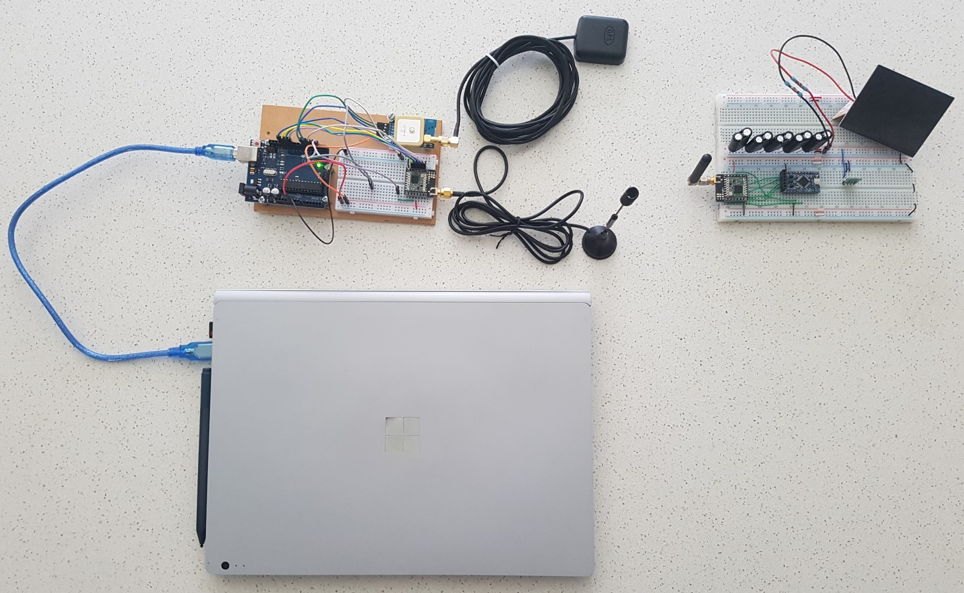
Design of a small satellite UHF radio beacon for Identification, Telemetry, Tracking and Control
Presented BY Pilot Officer Travis McKee
Thesis Supervisors: Dr Edwin Peters & Dr Craig Benson

Slide 2
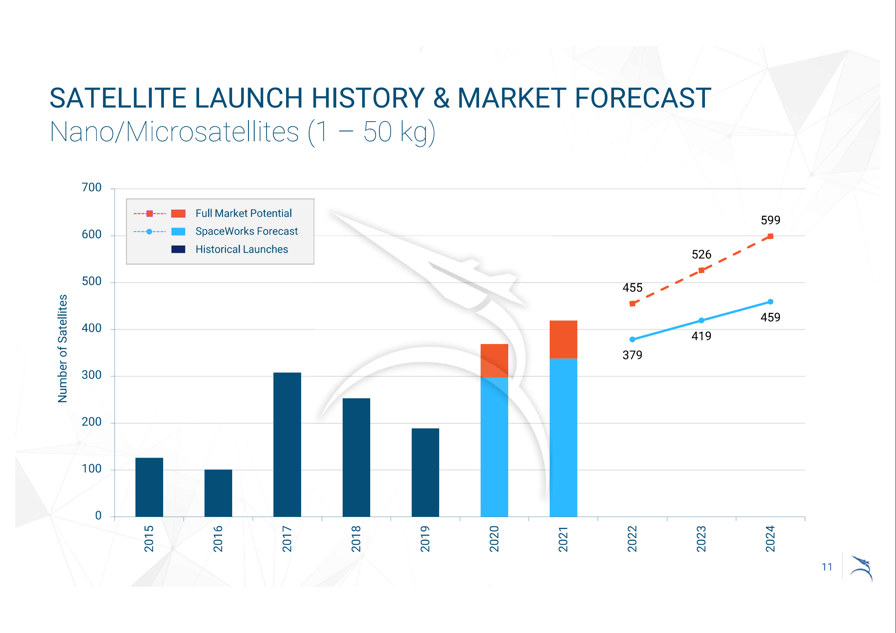
Introduction
“SpaceWorks estimates 1,800 – 2,400 nano/microsatellites will require launch over the next 5 years”
2020 Nano/Microsatellites market forecast, 10th Edition
Source: Space Works, 2020 Nano/Microsatellite market forecast, 10th edition,
Accessed at: https://www.spaceworks.aero/nano-microsatellite-forecast-10th-edition-2020/

Slide 3
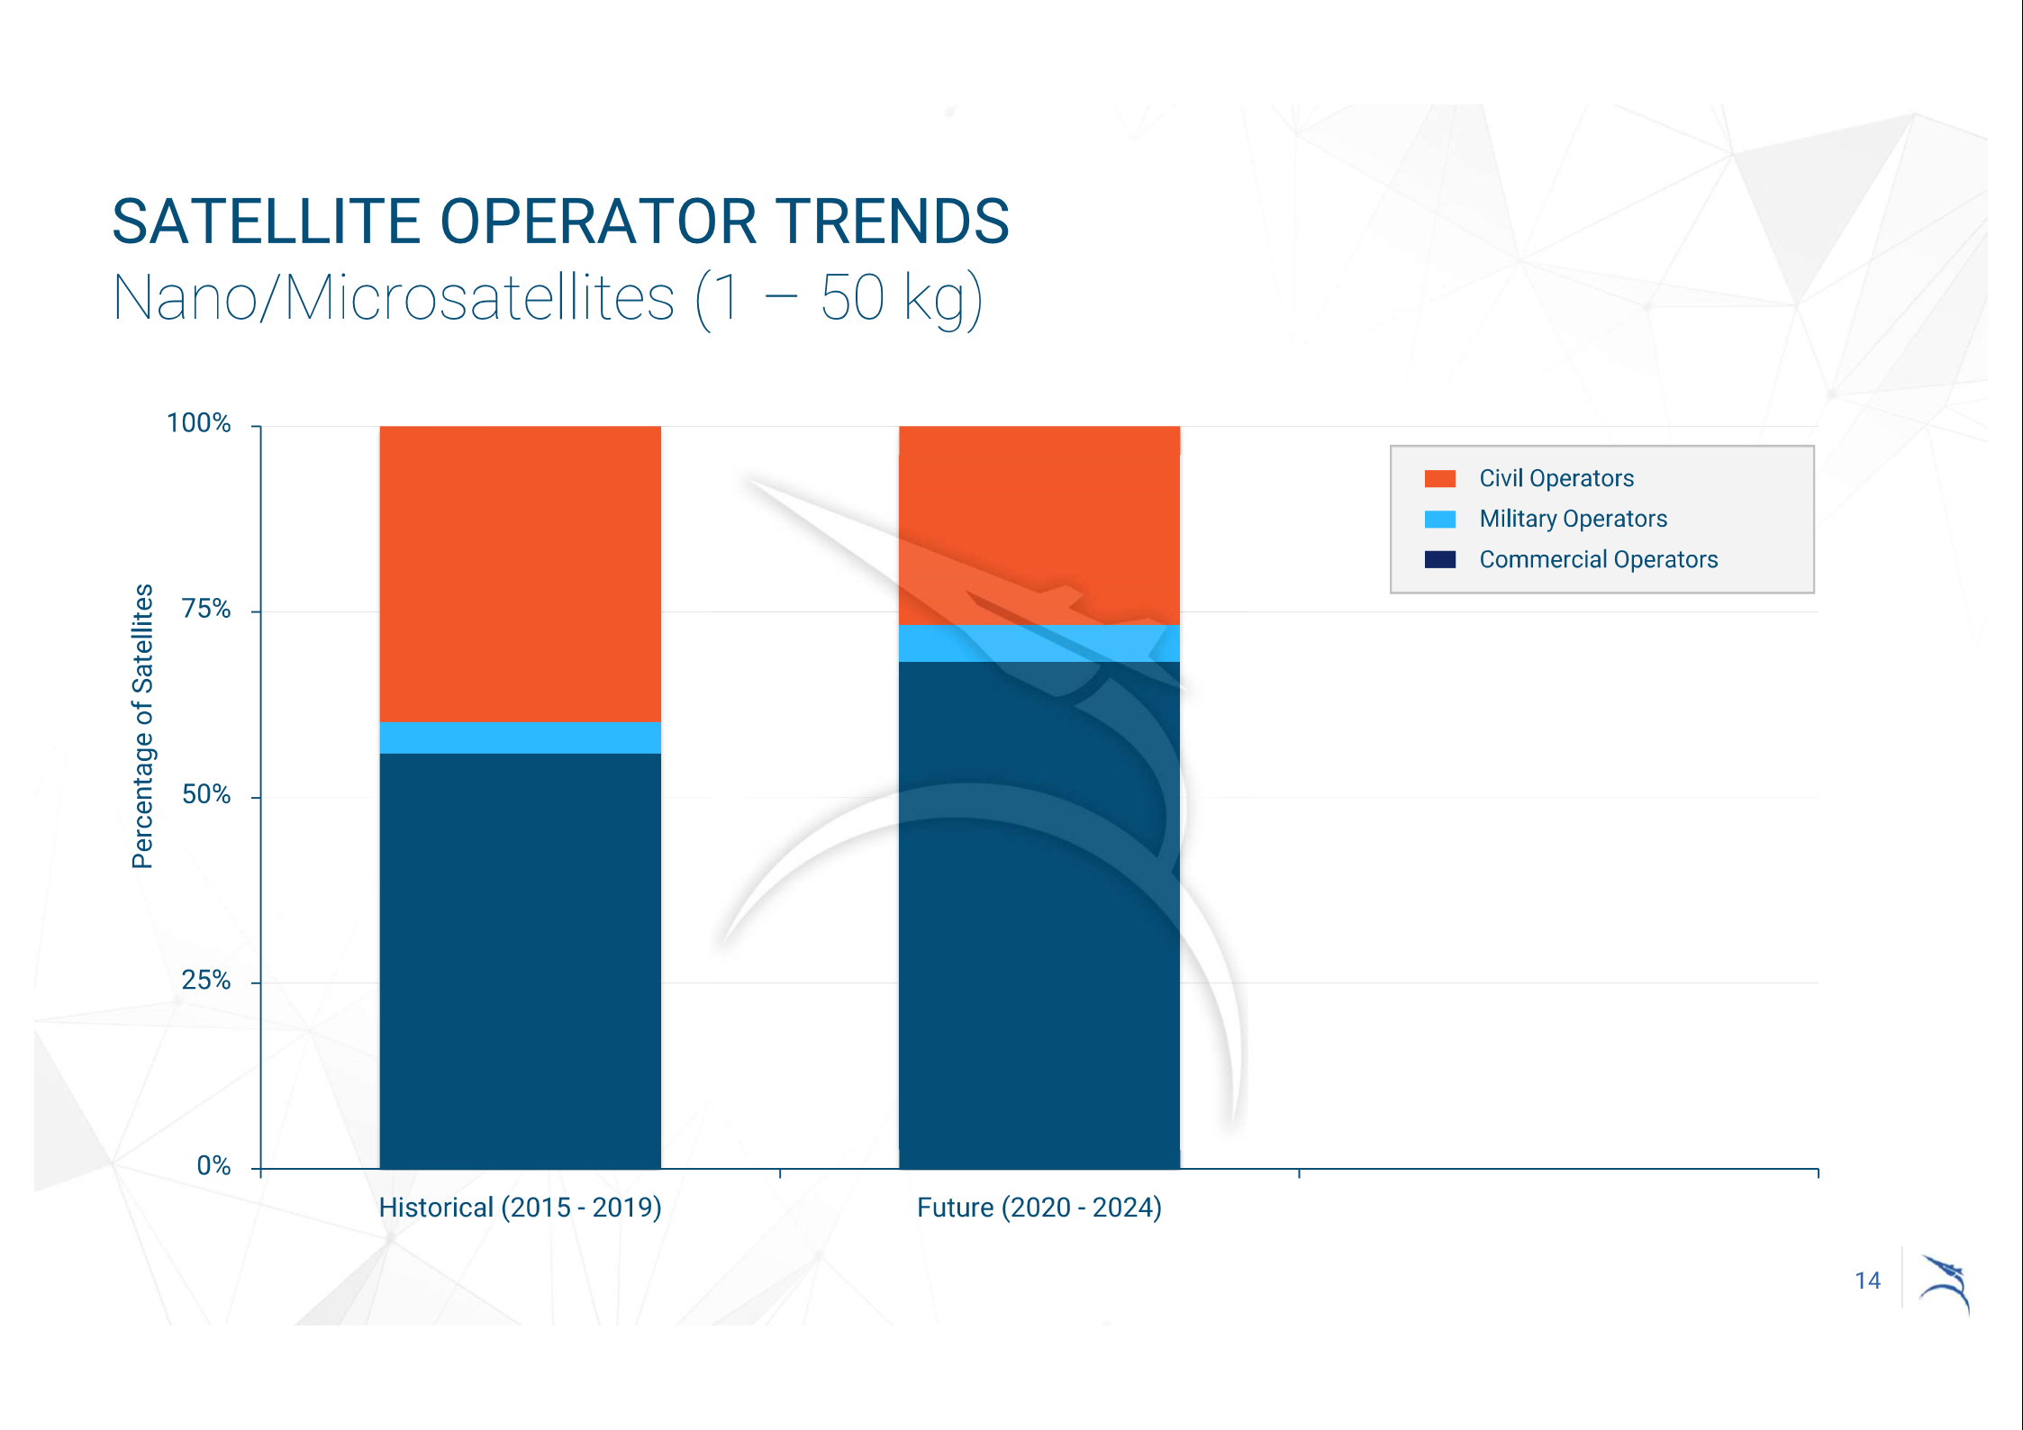
Introduction
“mission success rates average 45 percent and 77 percent between academia and industry, respectively. Missions were deemed a success if the CubeSat operated on orbit for 60 days or longer”
U.S. Space program Mission Assurance Improvement Workshop
Source: Space Works, 2020 Nano/Microsatellite market forecast, 10th edition,
Accessed at: https://www.spaceworks.aero/nano-microsatellite-forecast-10th-edition-2020/

Slide 4
Introduction
The growing number of objects and the increase in uncontrollable space debris in the Low Earth Orbit (LEO) space environment has produced additional challenges for operating and monitoring in the LEO environment.
The problems that this project aims to address
The increased demand on expensive ground monitoring equipment to maintain Space situational awareness (SSA) in the Low Earth Orbit (LEO) environment
The large failure rate of small satellites operated in the LEO space environment
The difficulties in identifying a small objects in the LEO environment

Slide 5
Introduction
What is required to address the problems:
A cost-effective system of tracking active, End of Life and failed small satellites in the LEO environment.
A method of obtaining the telemetry data of a small satellite irrespective of a failure in any other satellite system
A better technique of uniquely identifying an object in LEO regardless of a failure in any other satellite system
Providing an alternative communications pathway for a satellite control system redundancy

Slide 6
Introduction
The purpose of this project
To design a self-sufficient, independent satellite radio beacon system in which:
Satellite identification and telemetry data can be transmitted from the satellite radio beacon to a ground receiving station
A control command can be transmitted from a ground station to the radio beacon
The satellite radio beacon can provide a UHF RF signal that can be tracked by multiple cost-effective, graphically dispersed ground receiving stations

Slide 7
Introduction
The value of this project is:
It provides a cost-effective tracking system which increases SSA in the LEO environment and reduces the reliance on expensive space monitoring equipment
The unique identification of small satellites after launch and during its operational lifecycle increases SSA in the LEO environment and can decrease the rate of failure
The provided satellite telemetry and health data can facilitate on-orbit fault-finding to determine the cause of satellite failure, which can lead to a reduction in satellite failure rates
It allows an alternative communications pathway for beacon and satellite control to correct an on-orbit failure, reducing the number of space debris objects

Slide 8
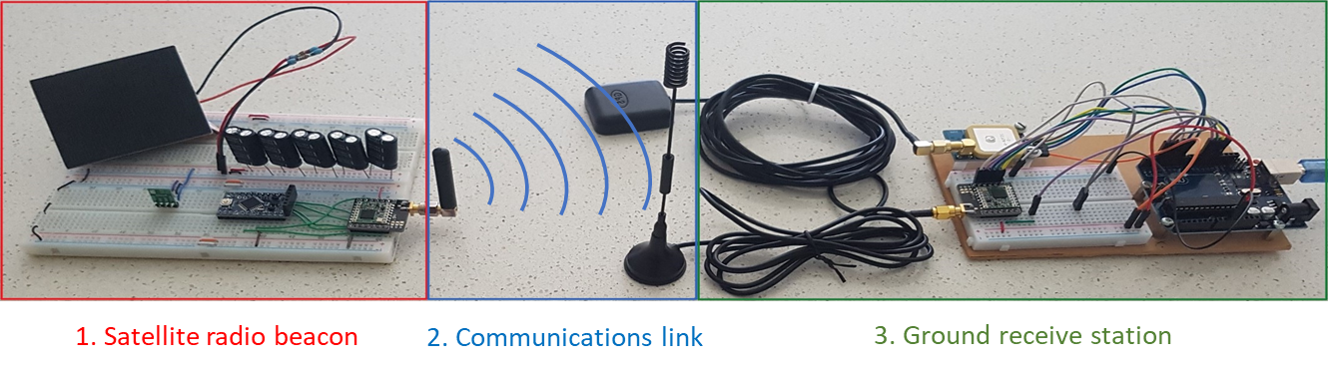
Theory of Operation
The Satellite UHF radio beacon system will be separated into 3 components:
The satellite radio beacon – A self-sustained UHF communication system that can operate independently of all other satellite systems for the duration on the satellites mission (until deorbit)
The communications link – Can support the reliable transfer of data between the satellite radio beacon in LEO to a ground receive station, which has an estimated maximum slant range of
The ground receive station – Can capture the satellites identification, telemetry data, record the precise time of arrival of the RF signal, determine its own global location and pass this data to a peripheral device for processing.

Slide 9
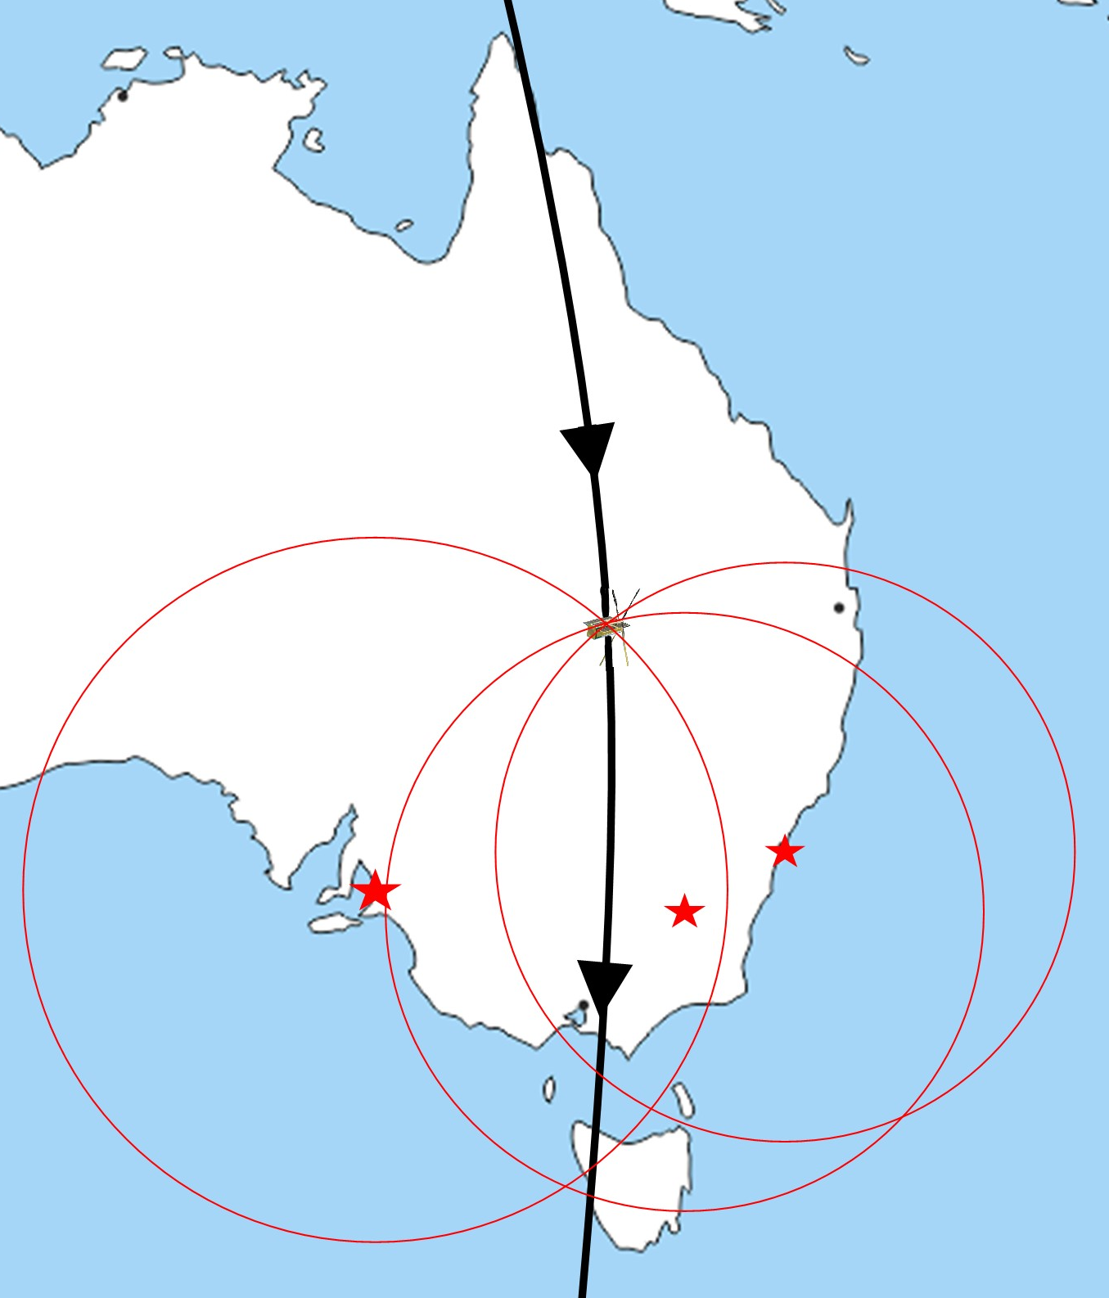
Theory of operation
The satellite beacon is linked with the other satellite systems to collect telemetry data and contains a unique 16-Bit address.
The address and telemetry data are placed into packets and transmitted from the beacons UHF radio at 437MHz for collection at multiple graphically dispersed ground stations.
At the conclusion of the transmission, the beacon has a short period of time to receive command data to enable control of the beacon and other satellite systems.
The ground stations colects the received data and the precise time of arrival with reference to a common timing source and passes this data along to a peripheral device for post processing.
The time of arrival between the three ground stations allows for the trilateration of the satellites position using the Time Difference of Arrival (TDOA) calculation technique.

Slide 10
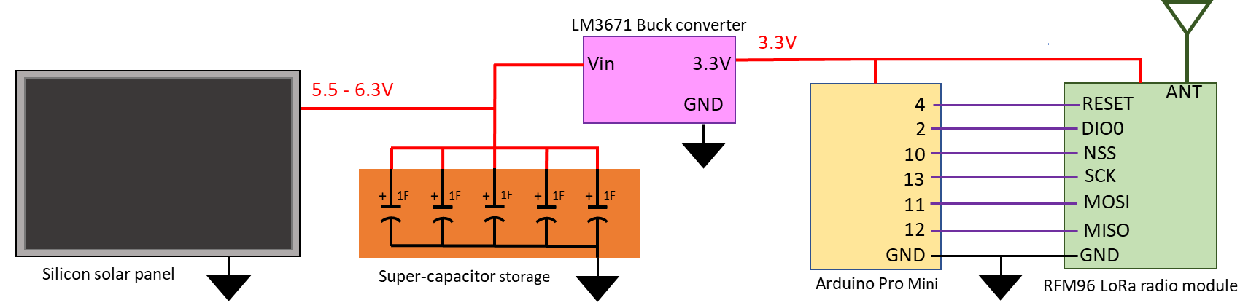
Satellite Radio Beacon
The satellite radio beacon must be self sustaining and independent of all other satellite systems
To achieve these aims the satellite beacon must contain its own:
Processor – Arduino Pro Mini (APM) module which contains the ATMEGA328P processor
Radio Transceiver – RFM96 LoRa radio module, which uses ultra-long range spread spectrum communication techniques with a high interference immunity
Power Generation, storage and regulation – 0.5W monocrystalline silicon solar panel (for ground testing), a super-capacitor storage system and a DC-DC buck converter

Slide 11
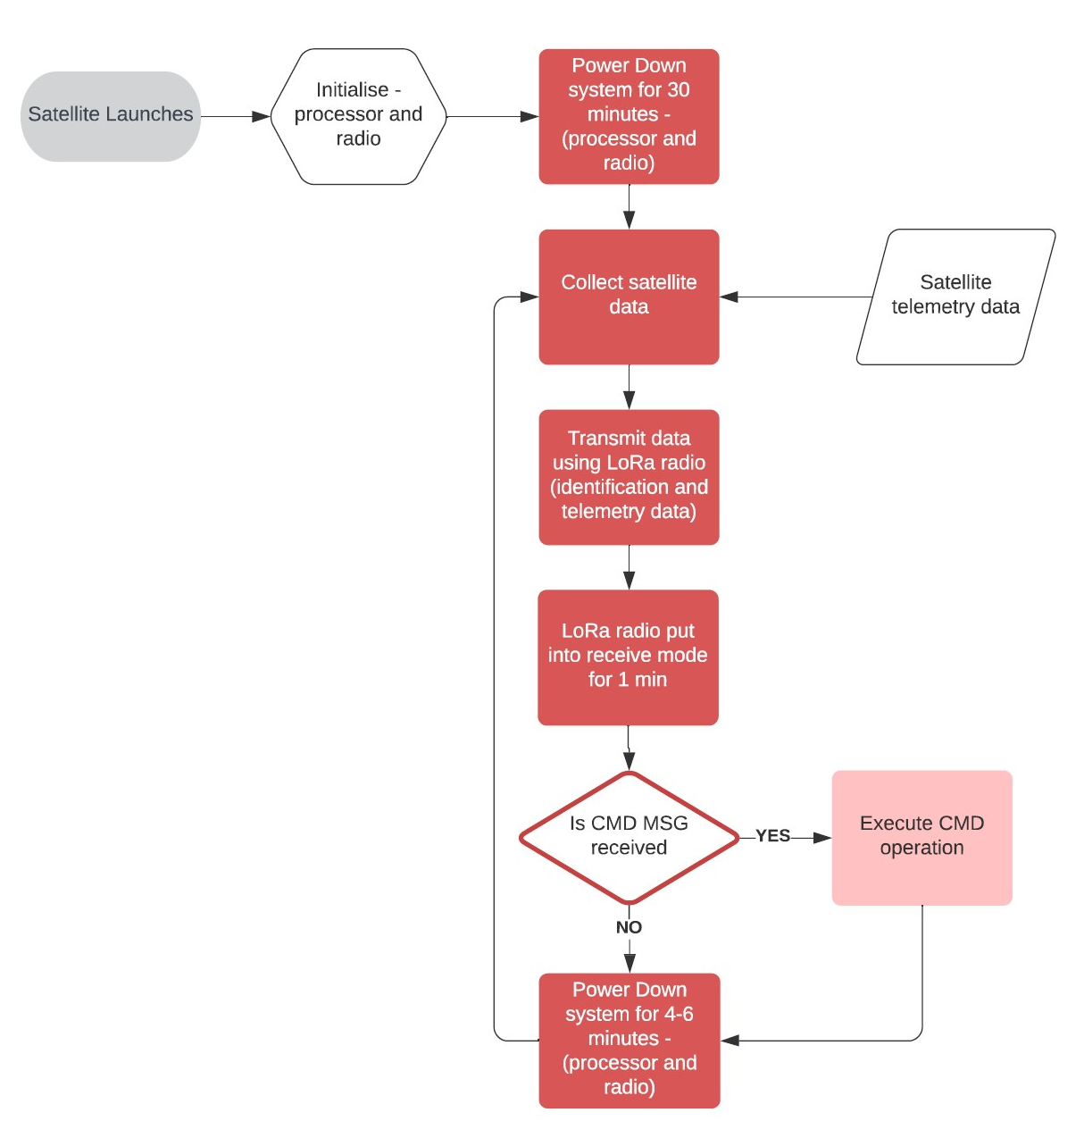
Satellite Radio beacon
The software cycle for the radio beacon is shown to the left which was developed to comply with the following requirements:
The beacon must maintain a radio silence for a minimum of 30 minutes after release from the launch vehicle, with the time changing for difference launch providers
The radio beacon must contain a receive period in which the radio can receive a command to cease transmissions, required for using the RF spectrum as determined by ACMA and ITU (435-438MHz amateur satellite band)
A variable time period for the power down phase in the software cycle to prevent synchronisation between satellites

Slide 12
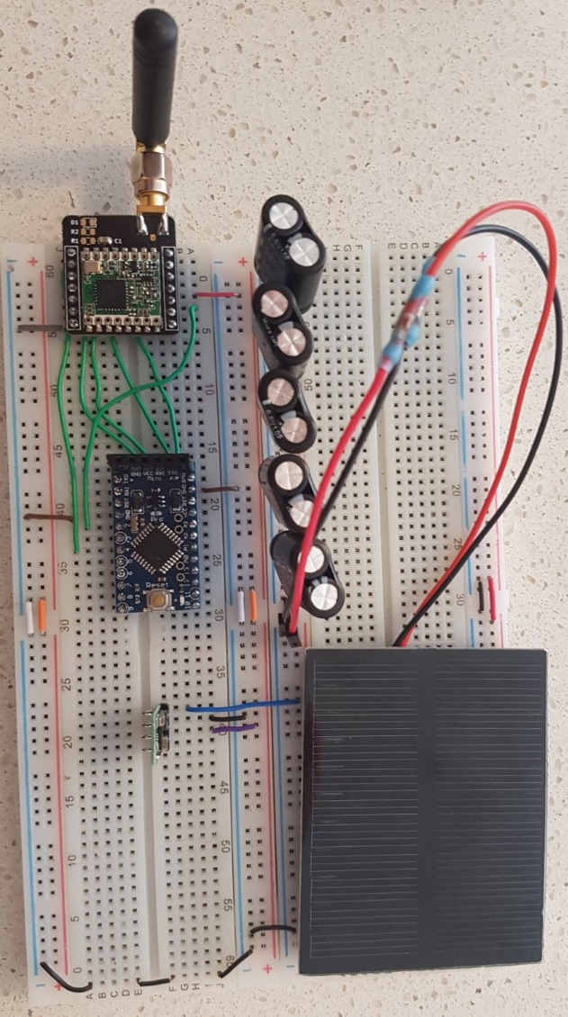
Satellite Radio beacon
The goal of the satellite radio beacon testing is to minimise Size, Weight and Power (SWaP) of each component. The testing carried out was focused on minimising the current consumption of the following components:
APM module processor – Test processor power modes
LoRa radio module – Test Radio power modes, Transmission (TX) power and data packet sizes
Power regulator – Test consumption of multiple regulator types
Ground-based solar panel – Test total system current requirements against number of solar panels
Capacitor-based power storage – Develop and test power storage system for system requirements
Super-capacitor storage
LoRa radio Module
APM Processor Module
DC-DC Buck converter
Silicon solar panel

Slide 13
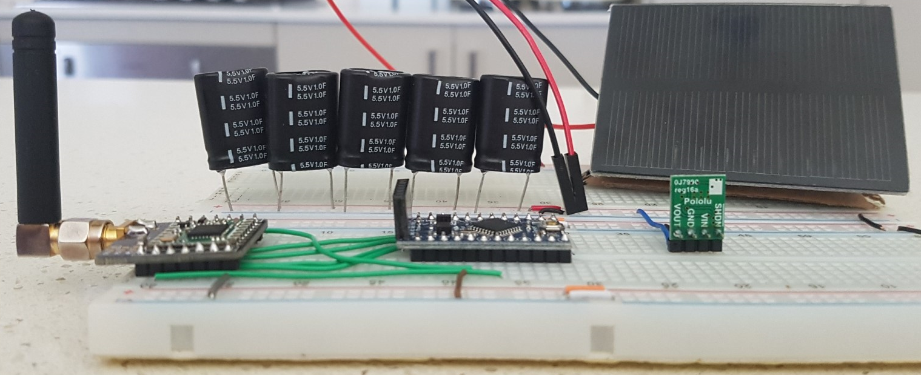
Satellite Radio beacon
The testing found the following methods to minimise the total current consumption of the beacon system:
Place the process into powerDown or powerSave low power modes where possible
Place the LoRa radio module into sleep mode where possible
Minimise the length of the receive and transmit phase in the software cycle
Reduce the LoRa radio TX power to as low as possible
Decrease the size of data packets to as small as possible
Utilize a more efficient voltage regulator (LM3671 DC-DC Buck converter)

Slide 14
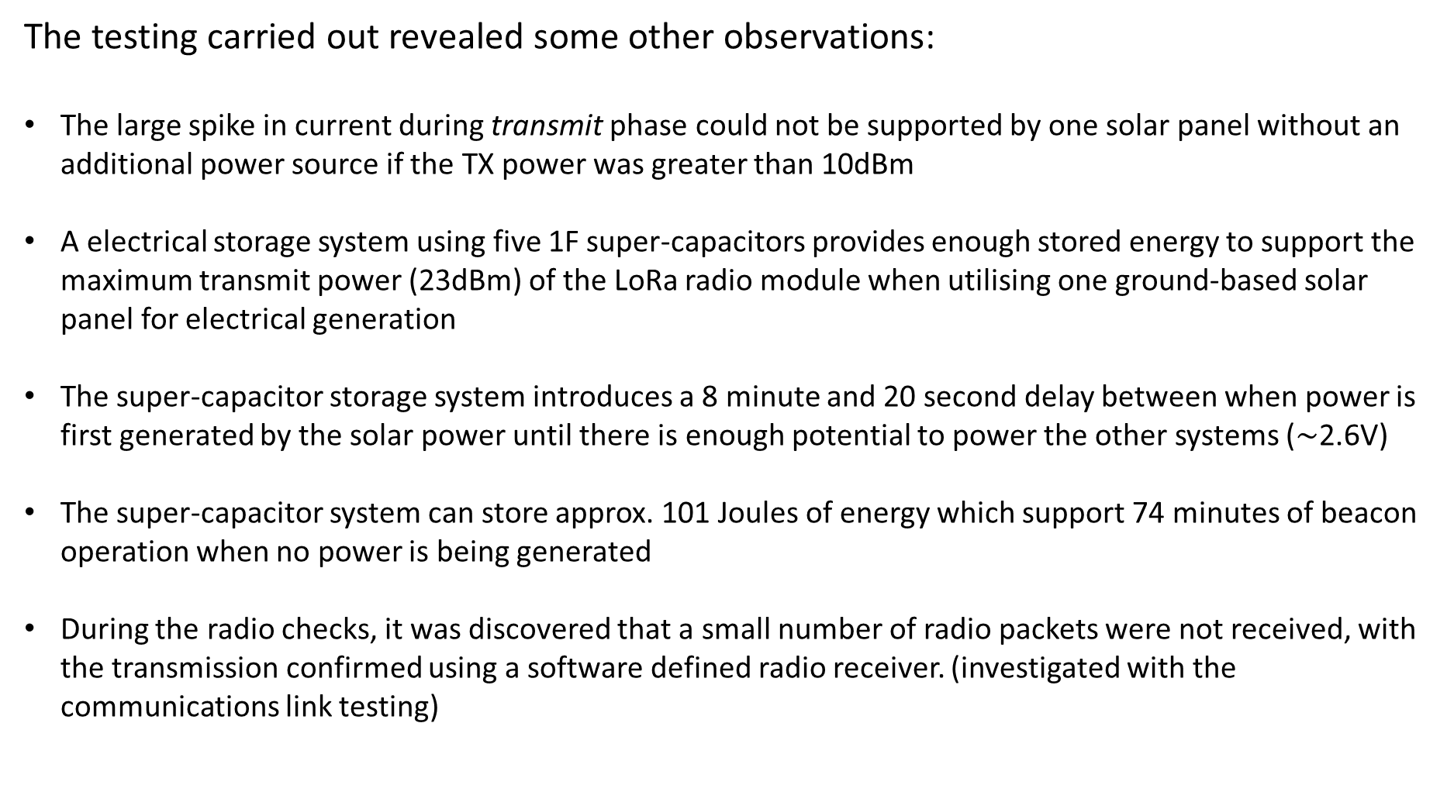
Satellite Radio beacon
The testing carried out revealed some other observations:
The large spike in current during transmit phase could not be supported by one solar panel without an additional power source if the TX power was greater than 10dBm
A electrical storage system using five 1F super-capacitors provides enough stored energy to support the maximum transmit power (23dBm) of the LoRa radio module when utilising one ground-based solar panel for electrical generation
The super-capacitor storage system introduces a 8 minute and 20 second delay between when power is first generated by the solar power until there is enough potential to power the other systems ($\sim$2.6V)
The super-capacitor system can store approx. 101 Joules of energy which support 74 minutes of beacon operation when no power is being generated
During the radio checks, it was discovered that a small number of radio packets were not received, with the transmission confirmed using a software defined radio receiver. (investigated with the communications link testing)

Slide 15
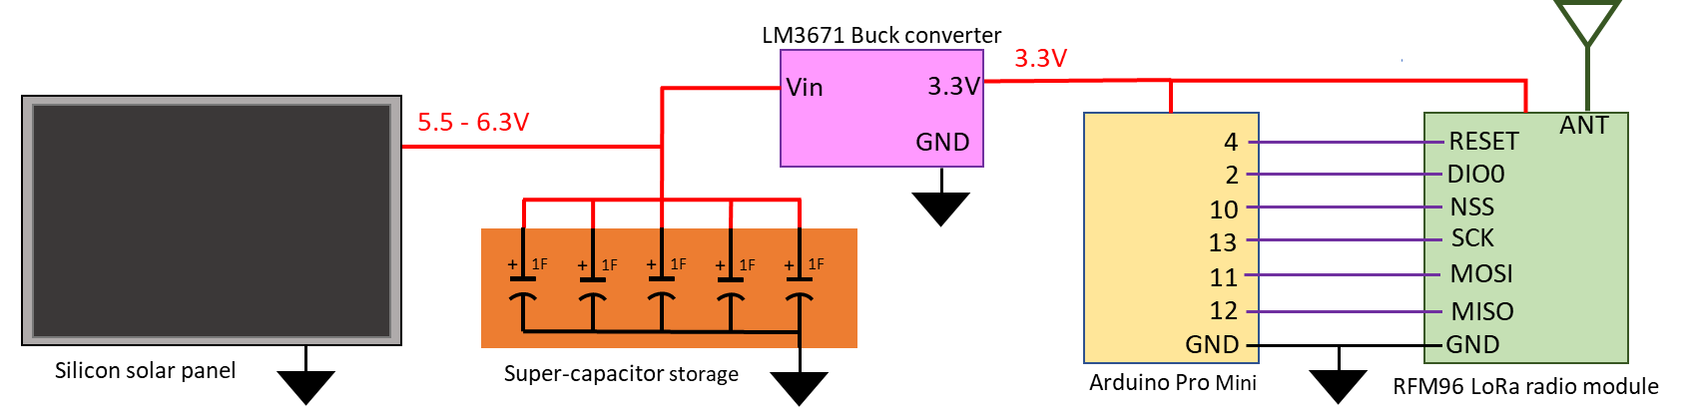
Satellite Radio beacon
The design of the initial prototype which can be constructed on a solderless bread board is shown below
The testing performed on the radio beacon prototype has shown that its operation is self sustaining and it is independent of all other satellite systems
The processor within the radio beacon has a combination of analogue, digital and serial connections to collect telemetry data from other satellite systems
The processor memory has 72% of flash memory and 50% of Static RAM remaining for the design of the data collection and command receive software program

Slide 16
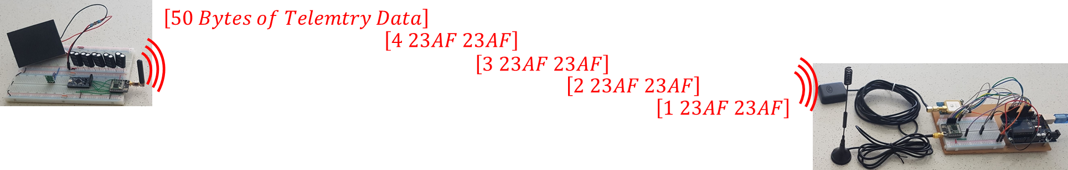
Communications Link
The satellite radio beacon must be self sustaining and independent of all other satellite systems, in order to achieve these aims the satellite beacon must contain its own:
Processor – Arduino Pro Mini (APM) module which contains the ATMEGA328P processor
Radio Transceiver – RFM96 LoRa radio module, which uses ultra-long range spread spectrum communication techniques with a high interference immunity
Power Generation, storage and regulation – 0.5W monocrystalline silicon solar panel (for ground testing), a super-capacitor storage system and a DC-DC buck converter

Slide 17

Communications Link
The initial investigation carried out was to determine the reason/s why the RFM96 LoRa radio module was not receiving the transmitted data packets
The proprietary nature of the software that drives LoRa radio module resulted in the reason for the dropped packet unable to be determined and no methods to bypass the LoRa receive process could be implemented
The testing process analysed over 1 million data packets with the receiving LoRa module dropping nearly 1% of the radio data packets transmitted which matches the RFM96 data sheet PER of 1%.
The high PER of the LoRa radio module resulted in a change of the data transmission method in which the transmitted identification and telemetry data will be separated

Slide 18
Communications Link
The next step in the testing the communications link of the satellite radio beacon system was to verify the reliable transfer of data between a small satellite in LEO and a ground receiving station by first calculating the communication Link Budget and then validating these calculations by conducting a ground based test.
The radio settings that were used for the testing were obtained from using the open-source RadioHead library which contains a set of default settings. The settings used for the testing was as follows:
Default (0) settings, Medium data rate and range – BW = 125kHz, 4/5 coding rate, SF = 128 chips/symbol Default (2) settings, Slow data rate and long range – BW = 31.25kHz, 4/8 coding rate, SF = 512 chips/symbol Default (3) settings, Slow data rate and long range – BW = 125kHz, 4/8 coding rate, 4096 chips/symbol
The link was tested using a maximum slant range expected is 2000km or 151.3dB free-space path loss (FSPL) which is based on 500-800km high sun-synchronous orbit with an inclination of 98°.

Slide 19
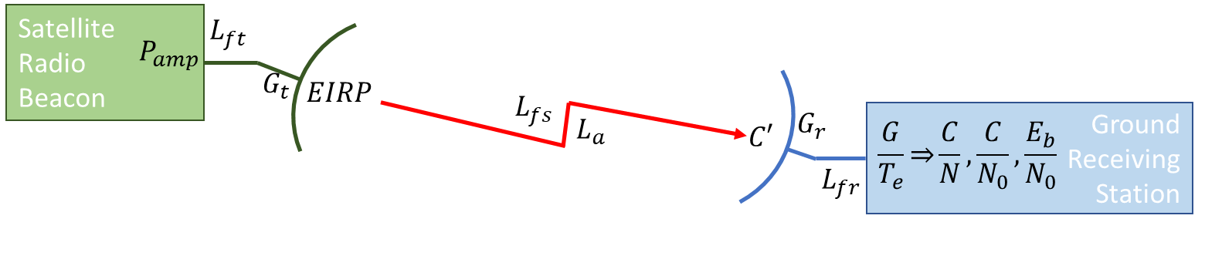
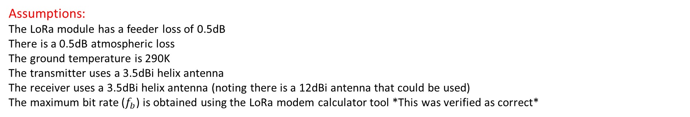

Communications Link
Link Budget Calculations
$$C^{′}=P_{amp}−L_{ft}+G_{t}−L_{FS}−L_{A}$$
$$\frac{C}{N_{0}}=C^{′}−10.\log\left(k\right)+\frac{G}{Te}−L_{fr}$$
$$\frac{E_{b}}{N_{0}}=\frac{C}{N_{0}}−10.log⁡(f_{b})$$
Assumptions:
The LoRa module has a feeder loss of 0.5dB
There is a 0.5dB atmospheric loss
The ground temperature is 290K
The transmitter uses a 3.5dBi helix antenna
The receiver uses a 3.5dBi helix antenna (noting there is a 12dBi antenna that could be used)
The maximum bit rate ($f_{b}$) is obtained using the LoRa modem calculator tool *This was verified as correct*

Slide 20

Communications Link
The ground based testing was carried out by physically connecting two LoRa modules using a set of coaxial cables and attenuators in which the total attenuation is equal to the free-space path loss.
The red values represent the calculated value of the coaxial cable attenuation using the values obtained from the datasheet for the RG174 cable, -60dB/m @ 437MHz
30-Bytes of data was transferred from the transmitter with the A and B attenuators slowly increased until the receiver stops receiving consist data which represent the maximum value of FSPL for which reliable data is received
The test was repeated for 5dBm, 10dBm, 15dBm and 20dBm transmit power for the (0), (2) and (3) default RadioHead settings

Slide 21
Communications Link
The calculated values for the link budget are presented below
The measured values from the ground testing are shown below

Slide 22
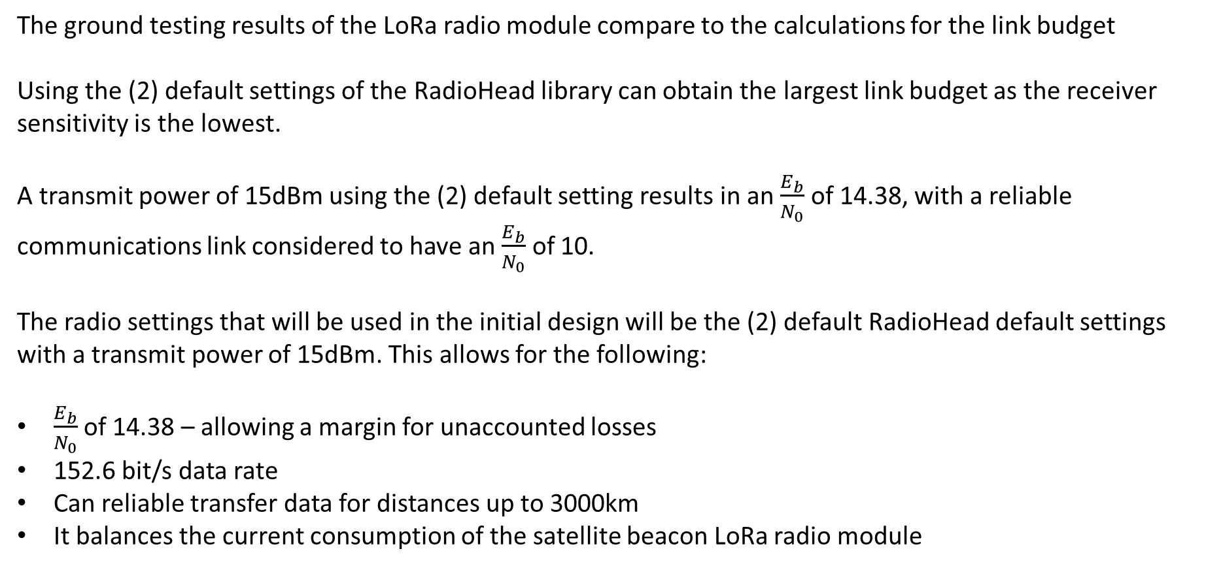
Communications Link
The ground testing results of the LoRa radio module compare to the calculations for the link budget
Using the (2) default settings of the RadioHead library can obtain the largest link budget as the receiver sensitivity is the lowest.
A transmit power of 15dBm using the (2) default setting results in an $\frac{E_{b}}{N_{0}}$ of 14.38, with a reliable communications link considered to have an $\frac{E_{b}}{N_{0}}$ of 10.
The radio settings that will be used in the initial design will be the (2) default RadioHead default settings with a transmit power of 15dBm. This allows for the following:
$\frac{E_{b}}{N_{0}}$ of 14.38 – allowing a margin for unaccounted losses
152.6 bit/s data rate
Can reliable transfer data for distances up to 3000km
It balances the current consumption of the satellite beacon LoRa radio module

Slide 23
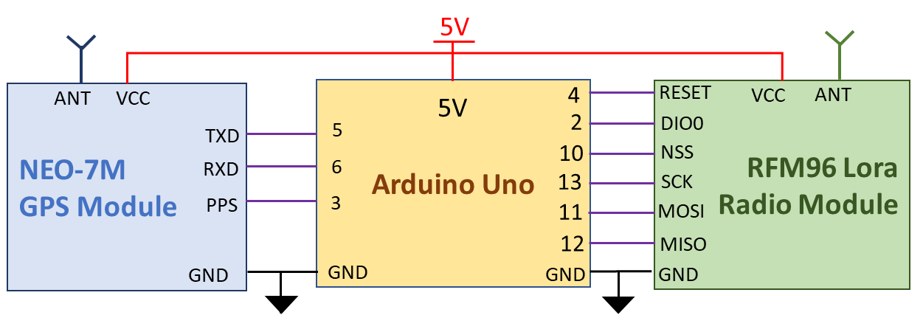
Ground Receiving Station
The initial design for the ground receiving station must be able to:
Collect the satellite identification and telemetry data
Transmit command data to the satellite beacon
Record the precise time of arrival of each received RF signal with reference to a common timing signal
Determine its global position using latitude and longitude
Pass all collected data onto a peripheral device for post processing
Be constructed using cost-effective, commercially available components

Slide 24
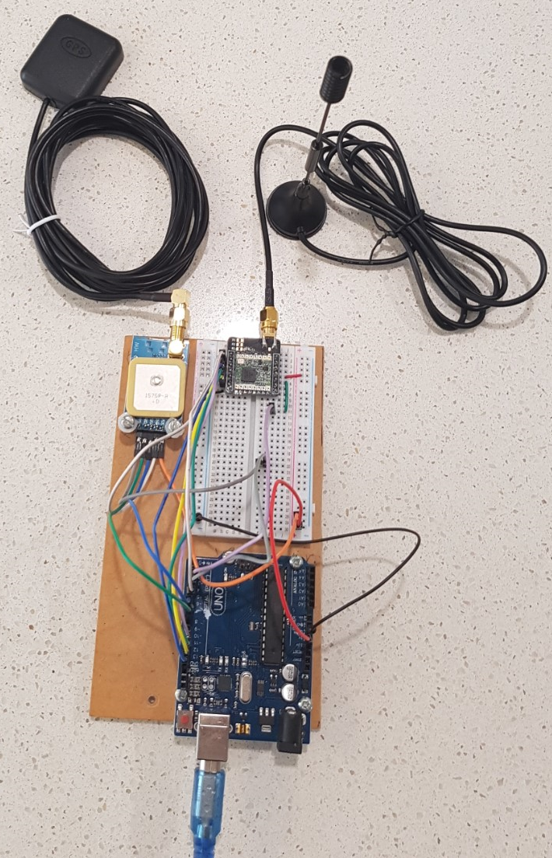
Ground receiving station
The initial design is based on an Arduino based processor (Arduino Uno) and the RFM96 LoRa radio module to ensure the data can easily be transmitted and received from the ground receiving station.
The Arduino Uno contains a type A/B standard USB 2.0 port which can be connected to any computer to transfer data for post processing.
A global positioning development module which is based on the U-Blox NEO-7M GNSS module is included in the initial design to provide:
The global Latitude/Longitude position of the ground station
Provides a Pulse per Second (PPS) signal that is synchronised to a Coordinated Universal Time (UTC) that has a 30ns tolerance
The total cost of construction including the antennas is under A$80

Slide 25
Ground receiving station
The 16-Bit Timer1 within the ATMEGA328P processor on the Arduino Uno board was used to measure the precise time of arrival of the received LoRa signal and the PPS pulse provided by the GNSS module.
The measurement of time was achieved by counting the number of clock cycles that occur between events with each clock cycle nominally measuring at 62.5ns (16MHz external oscillator with no external influences)
The number of clock cycles that occurred at a event are subtracted from the UTC time of the next GNSS PPS signal to occur which provides a common timing source between globally dispersed ground stations
The identified sources of uncertainty in the time measurement were:
The resolution of using the Arduino built-in timing function, micros()
The number of clock cycles taken to carry out a Interrupt Service Routine (ISR)
The drift in the oscillator frequency due to temperature, tolerances and other sources of error
The tolerance of the GNSS PPS signal
The accuracy of the ground station GNSS position
The time taken for the LoRa module in-built software to process and make the data available
The resolution of the external osciallator

Slide 26
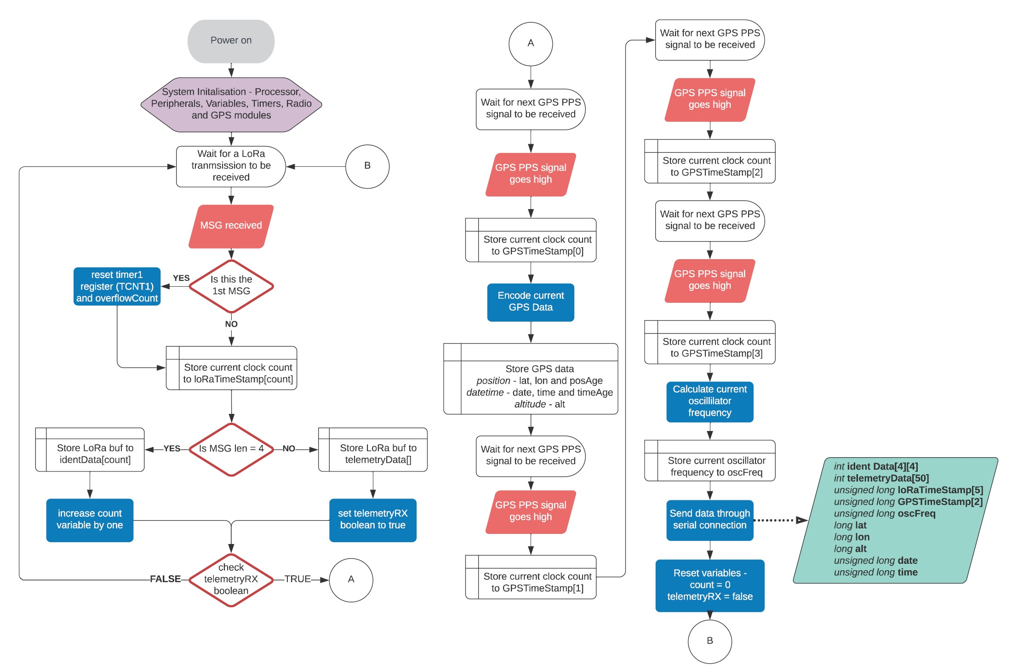
Ground receiving station

Slide 27
Ground receiving station
The ground station software is a reactive cycle which begins when an external interrupt on the Arduino Uno pin 2 is received from the LoRa module (first identification packet is received):
The TIMER1 is reset and the RX’ed identification data is stored
At the next Pin 2 interrupt (2nd Identification packet), the number of clock cycles that has occurred is stored and the RX’ed data is saved
This process is received for the next 2 radio packets (3rd and 4th identification packet)
For the next packet (telemetry data), the same process occurs with the telemetry data being saved
When the 5 radio packets have been received, the ground station waits for the next PPS signal to arrive from the GNSS module: to perform an external interrupt on the Uno Pin 3:
When the first PPS signal arrives, the number of clock cycles since the arrival of the first RX’ed signal is saved
The current GNSS data is read (ground station latitude, longitude & altitude and the UTC date & time)
For the next three PPS signals, the number of clock cycles are saved\
All collected data is then passed through the serial connection to the computer for post processing and the software cycle is reset

Slide 28
Ground receiving station
The testing of the ground station identified the following uncertainty in timing or distance measurement:
±3 clock cycles in using the TIMER1 measurement, equates to 56.5m
30ns tolerance of the GNSS PPS signal, equates to 9m
Tolerance of the GNSS position, 10m
5µs difference in LoRa processing time between 2 modules, 1.2km
The total expected uncertainty when measuring the difference of time arrival between two ground stations was estimated to be 5.25µs, which equates to an error of 1.575kms when estimating the position using the DTOA ranging technique.
It was found during the final verification testing that the uncertainty in determining the time of arrival was 1.5ms to 1.7ms which is a distance calculation error of 450-510ms.
The mostly likely cause of the large increase in uncertainty is the method in which the clock counting ISR is implemented in the complex ground receiving station software cycle. Further investigation into the clock counting ISR method is required with a focus on using timer capture mode

Slide 29
Conclusion
The aim of this project was to produce an initial prototype design for a self-contained and independent radio beacon that can transfer satellite identification and telemetry data from a small satellite in a LEO to a ground receiving station with the project extended to include a ground station tracking function.
The Satellite radio beacon prototype design has been tested and verified to be capable of
Operating with no input from any other satellite system
Collecting telemetry data from any other satellite system
Sustaining beacon operation using a singular solar panel
Executing a command received from a ground station
Transferring data reliably for a slant range distance of 2000km
The ground station protype design was capable of transmitting command data to the satellite beacon and receiving the transmitted satellite identification and telemetry data. The testing of the ground station indicated that the satellite positional uncertainty was 1.5kms when using the TDOA trilateration calculation method with the final verification testing revealing an uncertainty of 450-510kms.

Slide 30
Recommendations
The initial design for the small satellite UHF radio beacon system has proven the concept for the small satellite Identification, Telemetry and Control but further investigation of the ground receiving station is required to obtain a reliable and accurate tracking function
To reduce the uncertainty in the satellites positional calculation requires a reduction in the level of uncertainty in the time measurement technique. It is suspected that the large increase in time measurement uncertainty is a result of the implementation of the processor clock counting technique in the ground receive station software.
If the uncertainty of the satellites position can be reduced to an acceptable level then the development can continue on the system to:
Implement a TDOA algorithm that calculates estimated position based on Latitude/Longitude position
Develop a user interface program for the ground receiving station
Develop a server system for the collection and processing of ground station gathered data
Produce a satellite radio beacon design ready for space operation testing

